Slide 1
System Models
Chapter 02

Slide 2
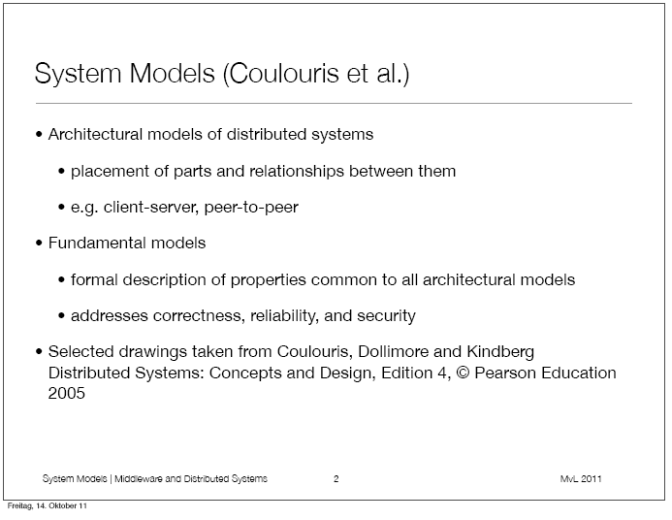

Slide 3
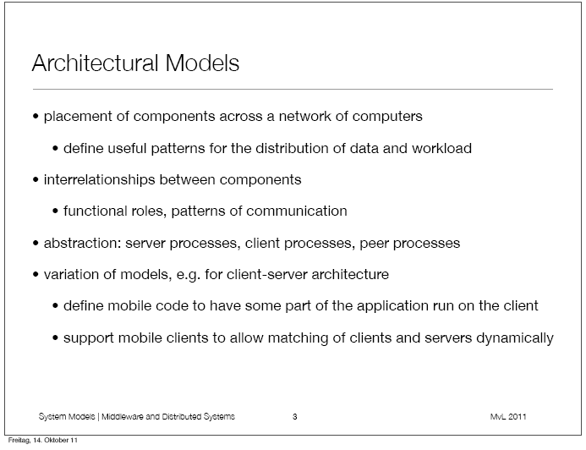

Slide 4
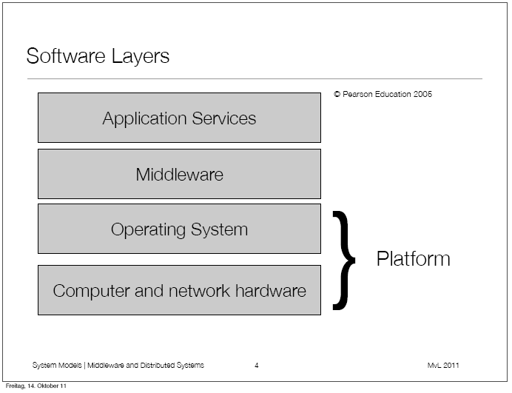

Slide 5
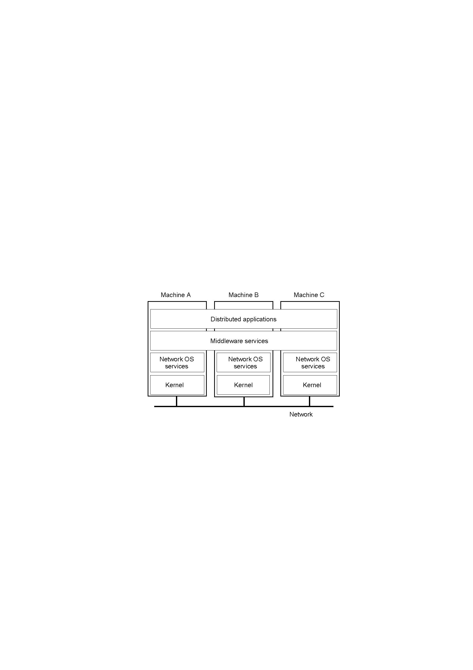
System Model
Architectural Model
Software layers in DS

Slide 6

Network Operating System
OSes can be different (Windows or Linux)
Typical services: rlogin, rcp
Fairly primitive way to share files

Slide 7
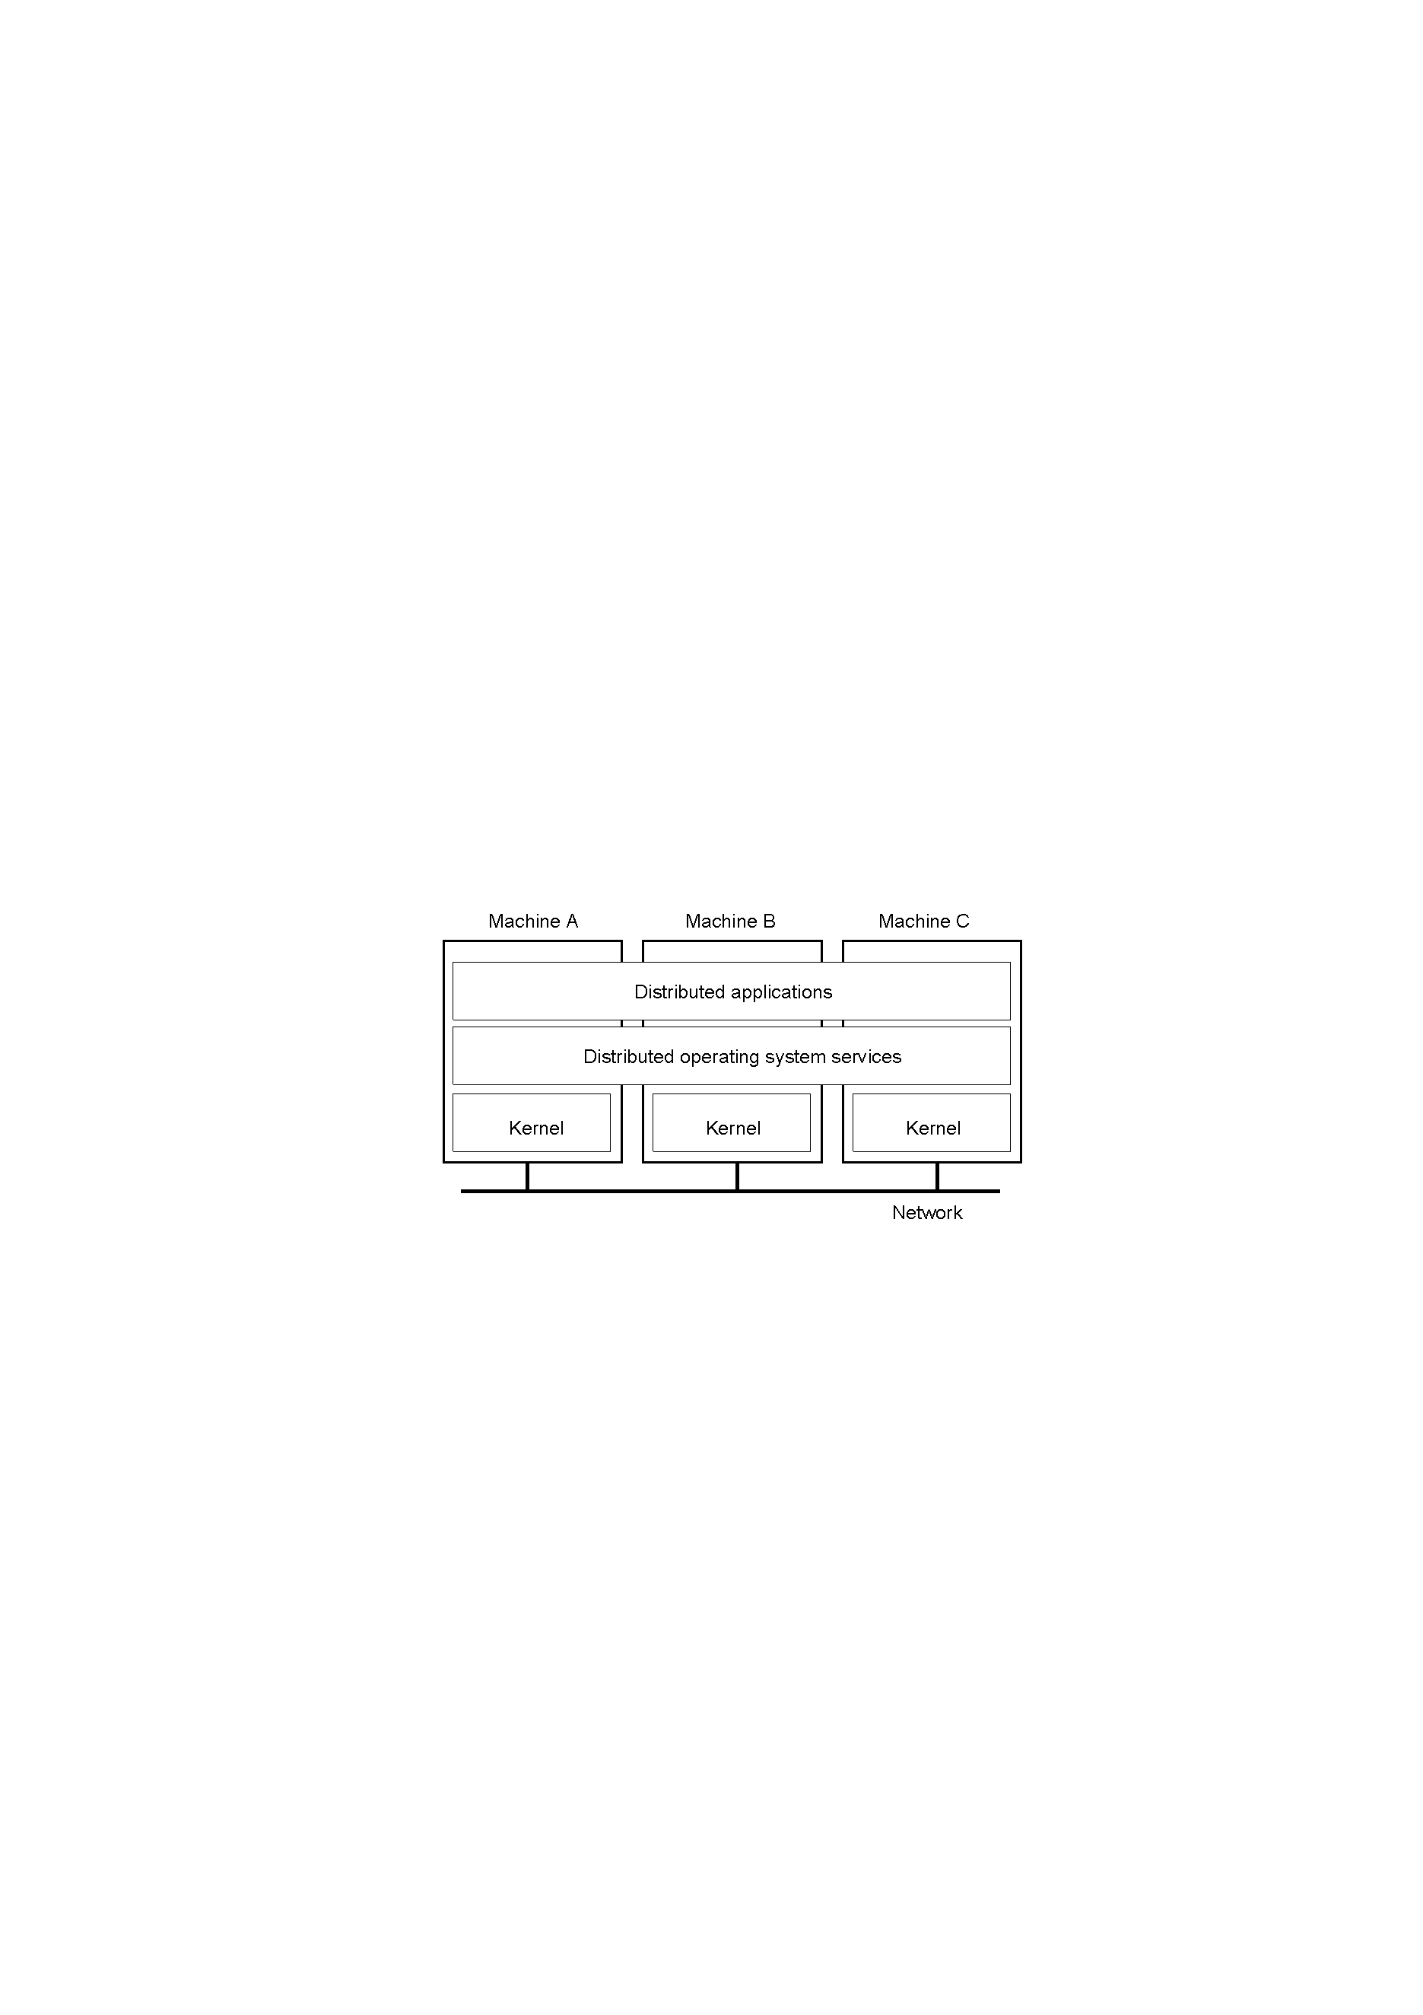
Distributed Operating Systems
But no longer have shared memory
Provide message passing
Can try to provide distributed shared memory
But tough to get acceptable performance

Slide 8
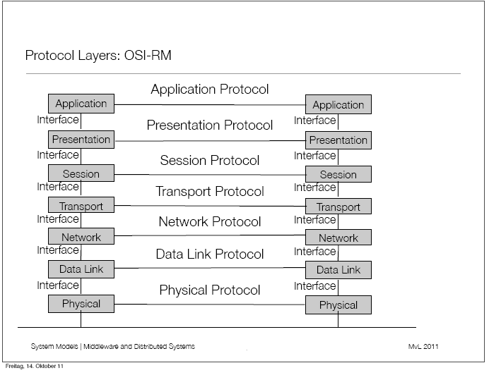

Slide 9
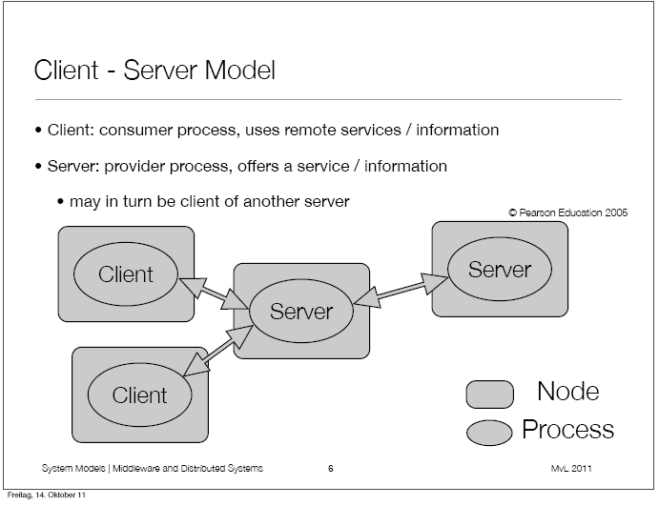

Slide 10
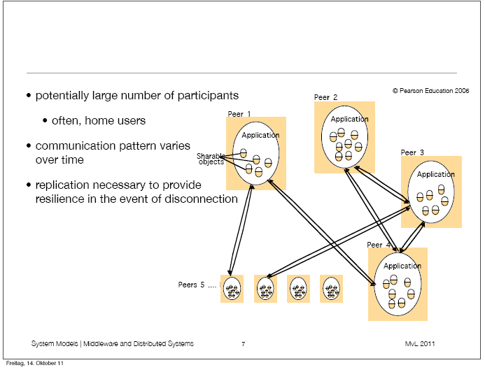

Slide 11
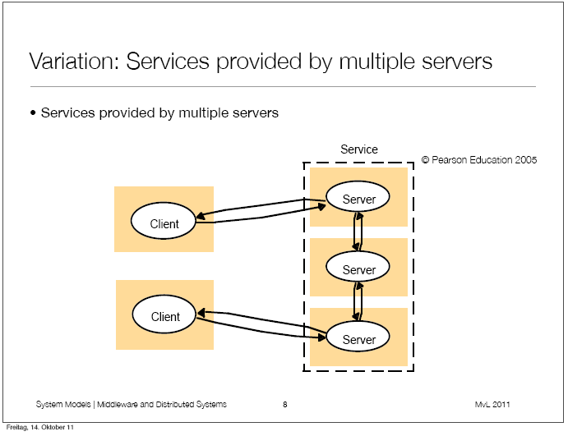

Slide 12
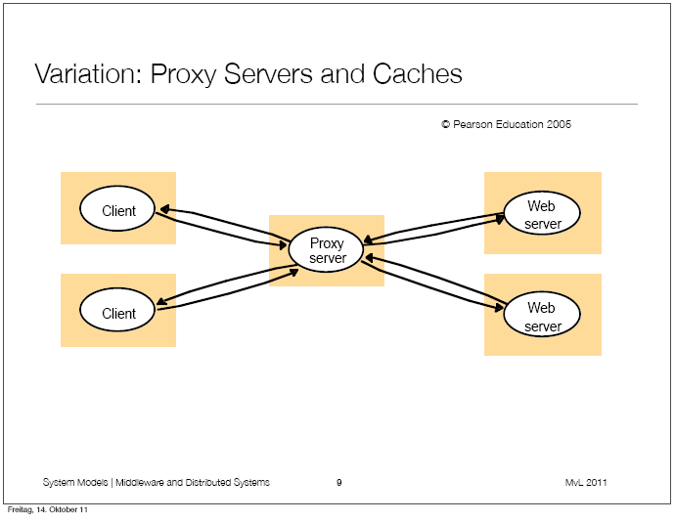

Slide 13
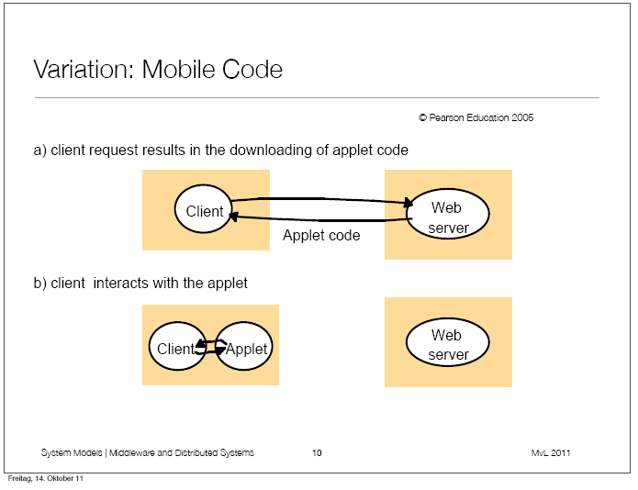

Slide 14
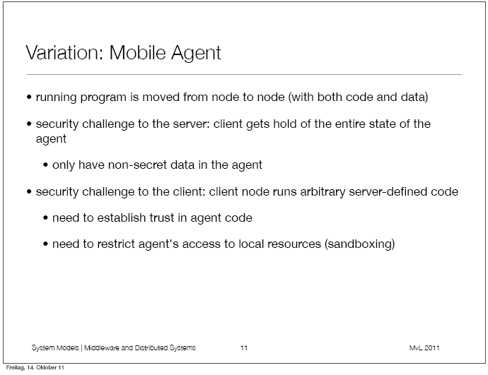

Slide 15
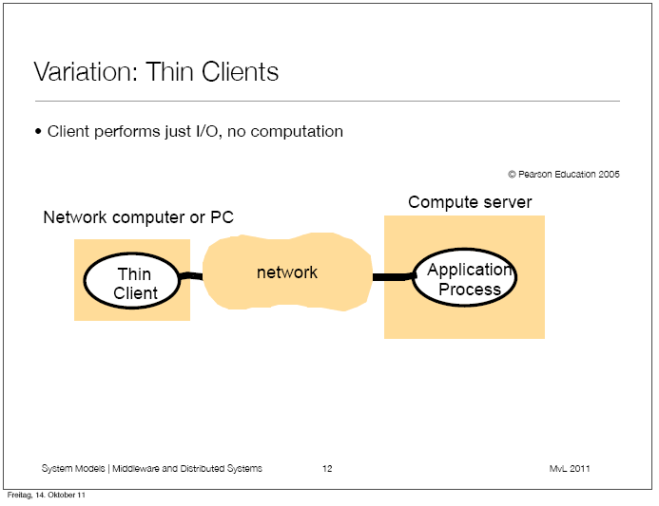

Slide 16
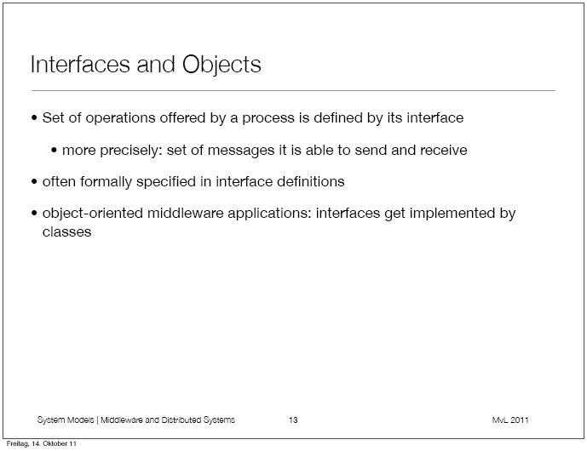

Slide 17
Interfaces
Interface definitions specify the set of functions available for invocation in a server (or peer) processes.
In object oriented paradigm, distributed processes can be constructed as objects whose methods can be accessed by remote invocation (CORBA Approach).
Many objects can be encapsulated in server or peer processes.
Number, types, and locations (in some implementation) of objects may change dynamically as system activities require.
Therefore, new services can be instantiated and immediately be made available for invocation

Slide 18
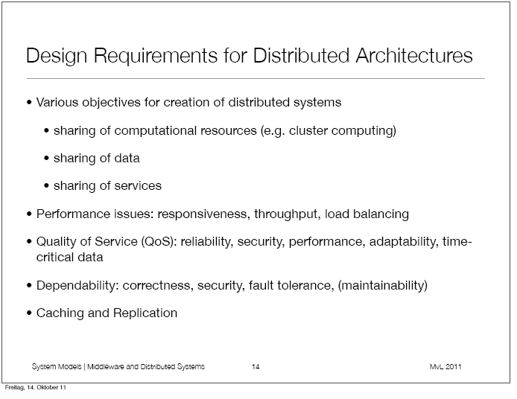

Slide 19
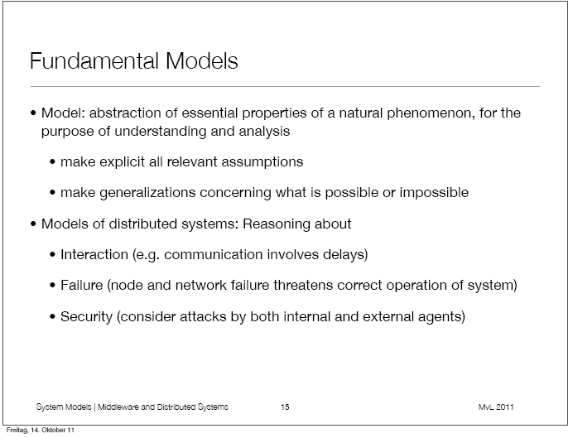

Slide 20
INTERACTION MODELS
Interaction Model Challenges
Distributed systems are composed of cooperating processes, interact in complex ways:
The rate at which each process proceeds and the timing of the transmission between them can not be predicted.
Difficult to describe all the states of a distributed algorithm.
4 Processes maintain their own private state
5 There is no single global notion of time.
-Clock drift rate – relative difference
process clocks differ from a perfect reference
clock.

Slide 21
INTERACTION MODEL
Performance Considerations: Communication over a computer network has following characteristic considerations.
Latency – delay between the transmission start of a message and its receipt.
- Time taken by the actual message transmission will vary with load of message traffic and time required by OS services to process messages.
2 Bandwidth – amount of information that can be
transmitted over a computer network in a given amount of time.
Jitter – Variation in time to deliver a series of message.
Jitter is relevant to multimedia data.

Slide 22
Two variants of the Interaction Model
In a distributed system it is hard to set time limits on process execution, delivery of message or clock drift rate.
1 Synchronous distributed system (strong assumption of time)
1.1- Boundaries known for time to execute each step of a process,
message transmission and clock drift rate (each process has a local clock whose drift rate from real time has a known bound ).
1.2- Timeouts typically used to detect failures
1.3- Ineffective resource sharing
2 Asynchronous distributed system (No assumption, No bounds)
2.1- No assumptions made on process time, message
transmission or clock drift. One process take negligible time
while other take years.
2.2- Event ordering cannot be dependent on time
2.3- More opportunity for resource sharing, but much
more complex design.

Slide 23
Real time ordering of events
We are interesting in knowing whether an event at one process occurred before, after or concurrently with another event.
The execution of system can not be described in terms of events and their ordering despite the lack of accurate clock.
Consider following set of exchanges between a group of email users X,Y,Z and A.
1 User X sends a message with subject meeting
2 User Y and Z reply by sending a message with re: meeting
3 In real time X’s message was sent first, Y reads it and reply, Z reads both X’s and Y’s message reply then sends another reply, which reference both X’s and Y’s messages. But due to independent delays in message delivery, message may be delivered as shown in figure.

Slide 24
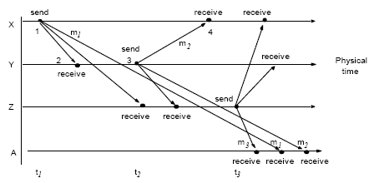
Real-time ordering of events
• Delivery time of messages cannot be predicted since clocks cannot be
perfectly synchronized across a distributed system

Slide 25
Lamport proposed Logical ordering – uses logical time to provide an order among events at process running in different computers in DS without depending on clocks.
Logically we know that a message is received after it was sent, so we can create a logical ordering for pairs of events. For example events concerning X and Y.
- X sends m1 before Y receives m1
- Y sends m2 before X receives m2
- Y receives m1 before sending m2
So we can infer a correct execution of process.
Finally- delivery time of a message can not be predicted since clocks can not be perfectly synchronized across a distributed system.
Logical ordering uses logical time to provide an order among events

Slide 26
2 Failure Models
In a DS both process and communication channel may fail.
Failure model defines the ways in which failure may occur in order to provide an understanding of the effects of failure.
2.1 Omission Failures: Process or communication channel fails
Process – halted (crashed) and will not execute any further. “Fail-stop” if other processes can detect this state.
Crash detection by using time outs.
Communication – messages are “dropped” between sender and receiver (sender buffer, receiver buffer or communication channel)
2.2 Arbitrary (Byzantine) Failures
Used to describe the worst possible failures in which any type
of error may occur.
For example- A process may set wrong values in it’s data items or it may return wrong values in response to an invocation.
Arbitrary failures of communication channels are rare because the communication software is able to recognize them and reject faulty messages.

Slide 27
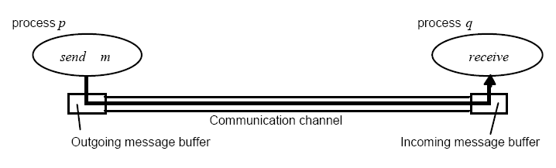
Processes and channels

Slide 28
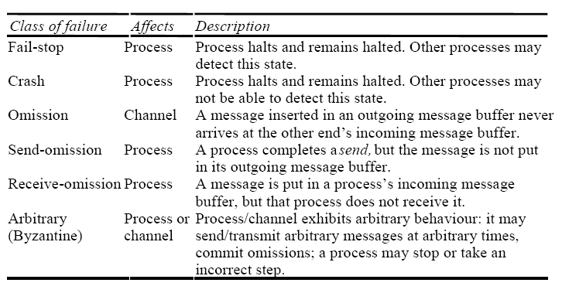
Omission and Arbitrary Failures

Slide 29
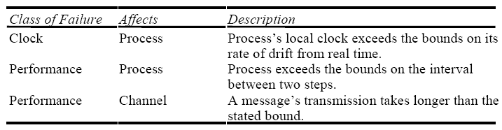
2.3 Timing failures
• Applicable in synchronous systems where time limits are set on process execution, message delivery and clock drift rate.
Real time operating system design with guarantee but they are more complex.
• Not applicable in asynchronous systems since no time limits can be
guaranteed.

Slide 30
Masking Failures
It is possible to construct reliable services from components that exhibit failures.
A knowledge of failure characteristics enable a new service to designed to mask the failure of the components on which it depends.
A service masks a failure by hiding it or converting it into a more acceptable type of failure.
System is said to be “fault tolerant”
Examples -checksums, message retransmission, redundant servers
Reliable communication (despite omission failures):
Validity – any message is eventually delivered
Integrity – message received is identical to
message sent, and no messages are delivered twice

Slide 31
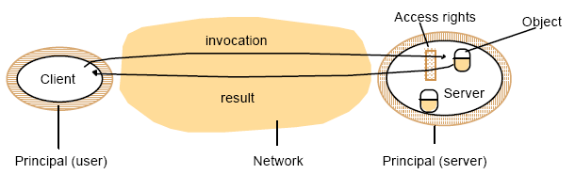
3- Security Model
Security of DS can be achieved by securing the processes and the channels used for their interactions and by protecting the objects that they encapsulate against unauthorized access.
Objects and Principles
Access rights – who is allowed to perform operations on the objects
Principle – authorities that possess access rights (user or process)

Slide 32
Security Threats
Enemy (adversary) legitimate or unauthorized connection to network.
Threats to processes – client or server cannot determine identity.
Threats to communication channels – enemy can copy, alter or inject messages
Denial of service – excessive requests with the intention of overloading resources
Mobile Code – Trojan horse attachments, viruses

Slide 33
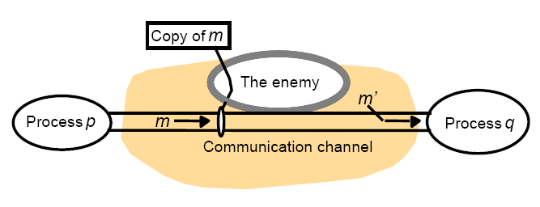
The Enemy

Slide 34
Defeating Security Threats
Encryption of messages using cryptography
- secret key pairs
Authentication of message senders
Secure channels
- service layer built on top of existing communication
services
SSL – secure socket layer
Make worst-case assumptions during design

Slide 35
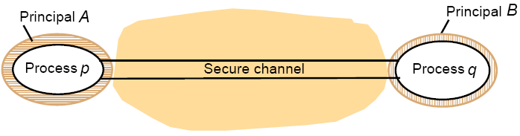
Secure channels

